Slide 1
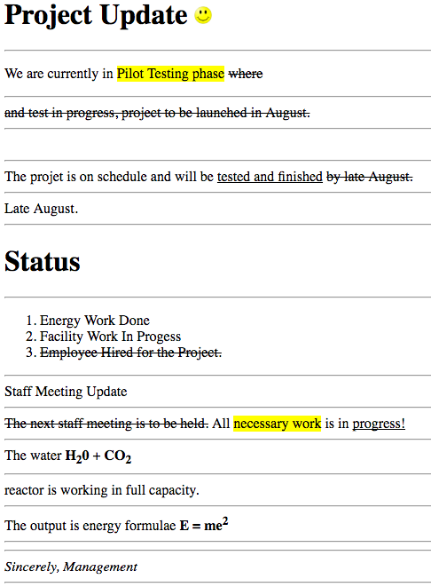
1. Write an Html code that display the following web page content

Slide 2
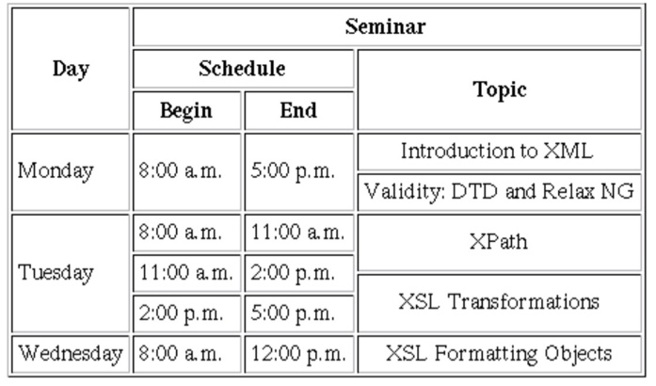
2. Write an Html Code that produce the following

